Slide 1
Tableau
A visual analytics platform

Slide 2
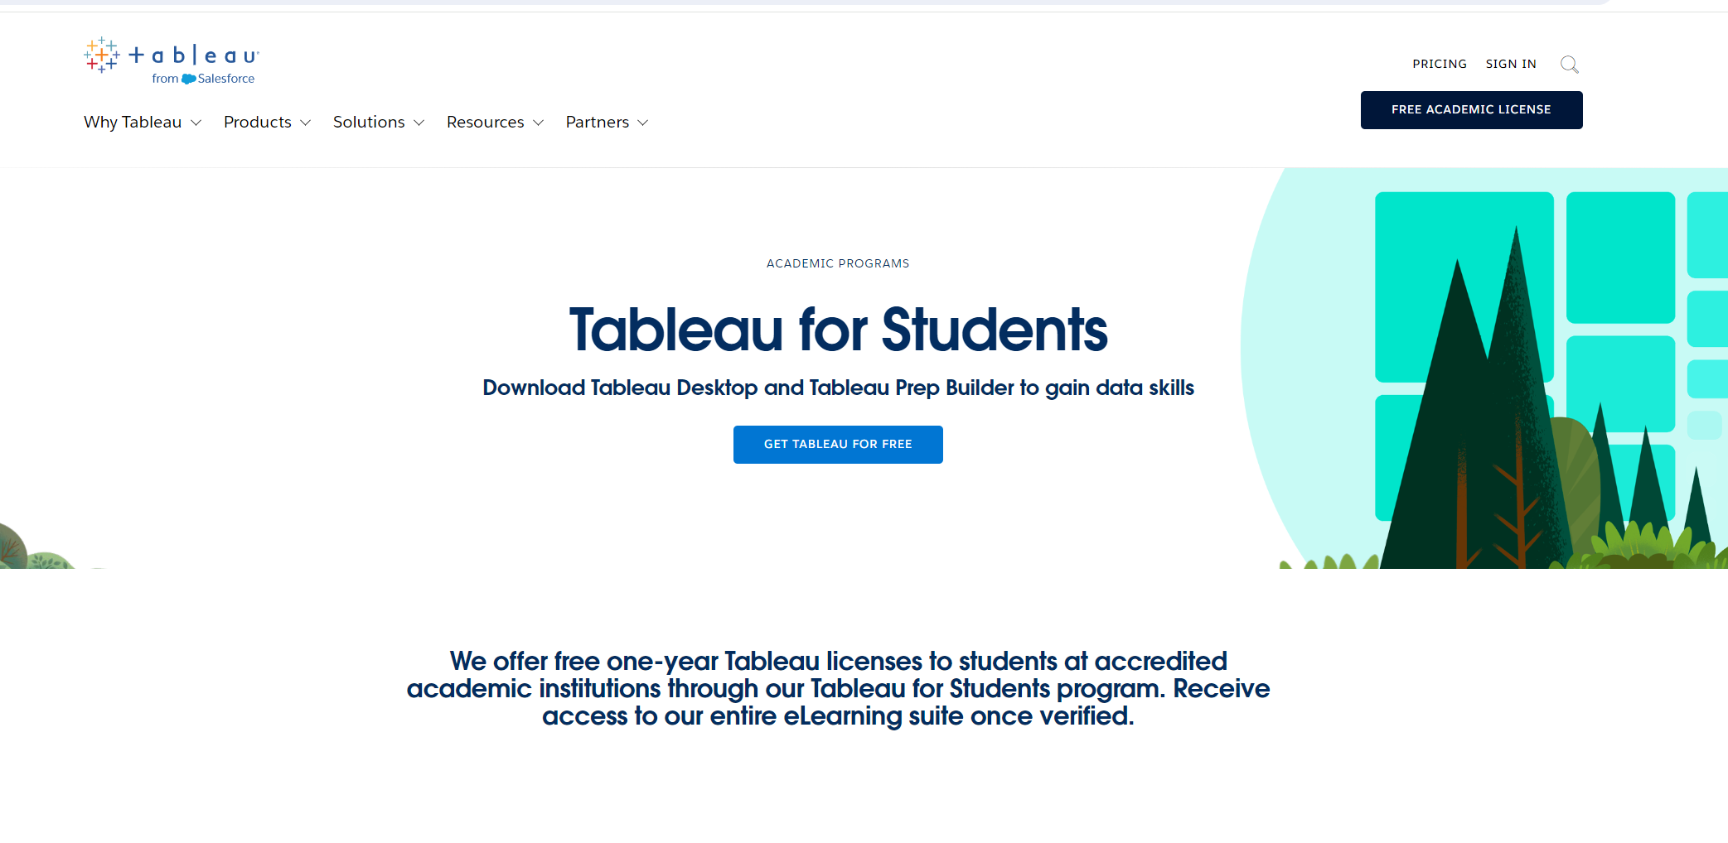
Install tableau

Slide 3
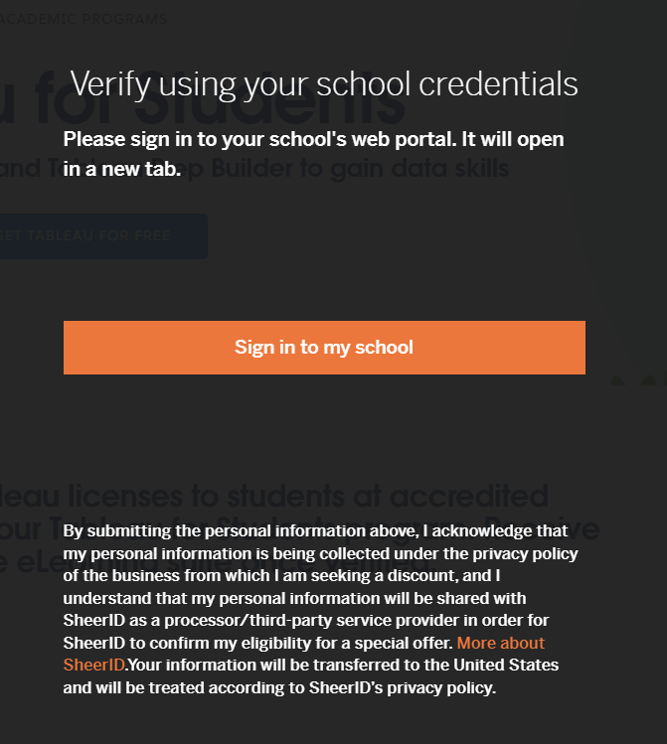
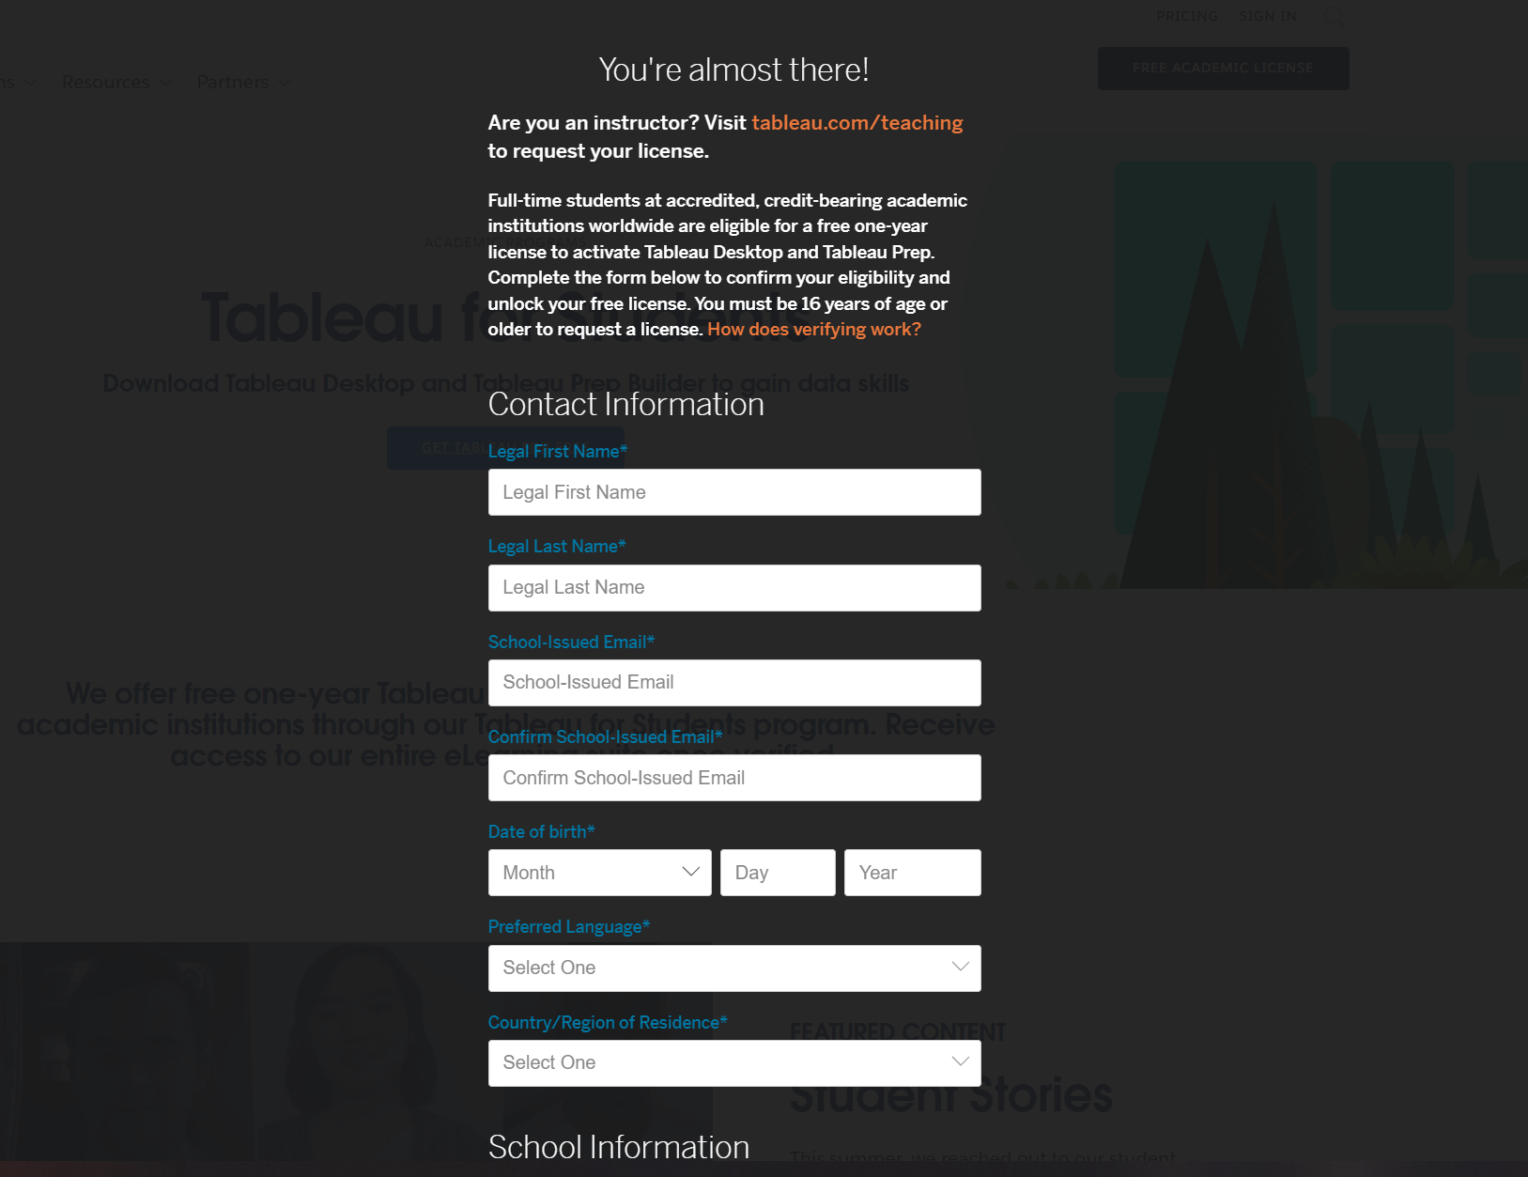
Please note that you may be required to upload your student ID card for verification purposes.

Slide 4
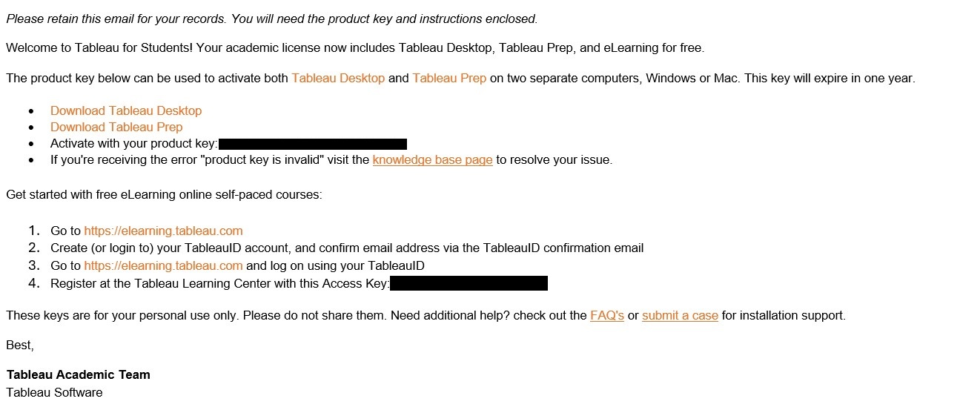

Slide 5
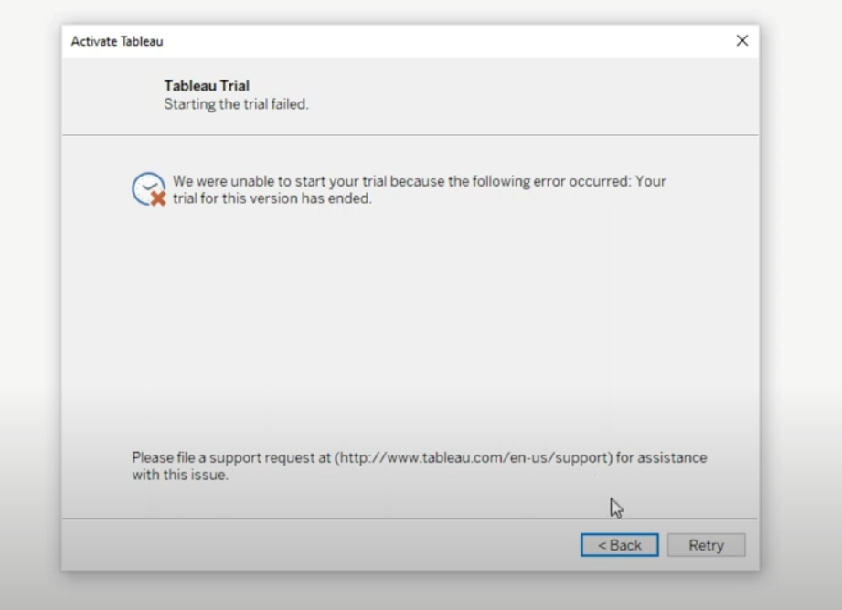
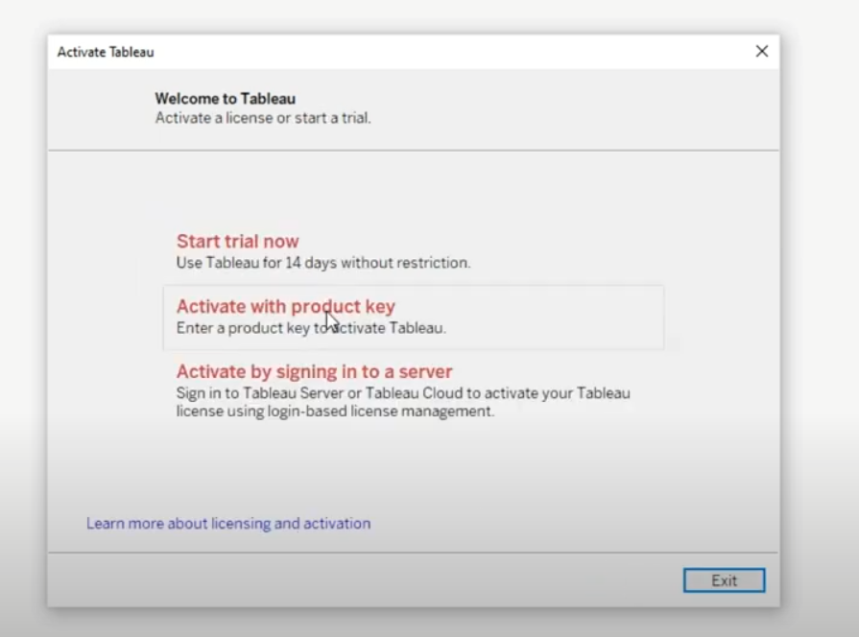

Slide 6
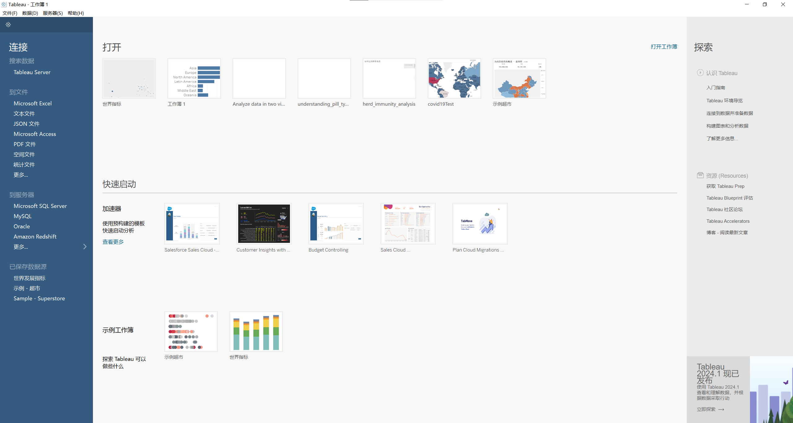

Slide 7
Workflow of Tableau
Data Connection: Connect to various data sources and import the data into Tableau.
Visualization Creation: Use drag-and-drop to create visualizations, customize them, and combine them into interactive dashboards or stories.
Sharing Insights: Publish and share dashboards with others for collaborative analysis and decision-making, with options for ongoing maintenance and updates.

Slide 8
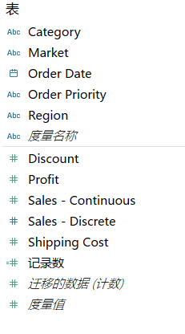
Dimension and Measure
Dimension: Dimensions are qualitative values such as names, dates, or geographical data. They are used to categorize, segment, and reveal the details in your data. Dimensions typically appear as headers in a table and define the granularity of the data. They are often used to create the axes on charts or as part of the partitioning for calculations. In Tableau, dimensions are usually represented by blue icons/fields.
Measure: Measures, on the other hand, are quantitative values. They are the numerical data points that can be aggregated - summed, averaged, counted, etc. Measures are typically used to perform calculations and create the numerical axis of charts or as values in a table. In Tableau, measures are usually represented by green icons/fields.

